Slide 1

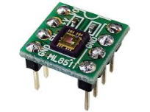

UV level
PV level
Time (s)
(a) PV and UV levels under the natural environment
UV level
PV level
Time (s)
(b) PV and UV levels change when the UV sensor
is intentionally blocked by a finger

